Slide 1
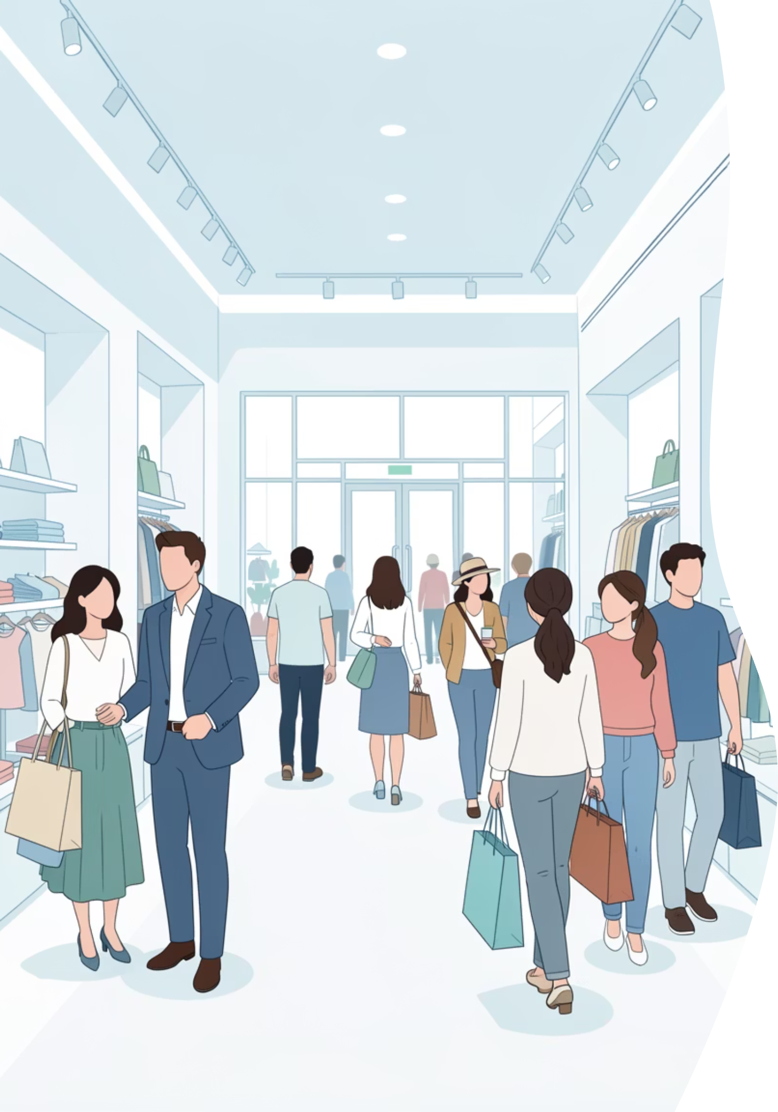
Customer Shopping Behavior Analysis
This project analyzes customer shopping behavior using transactional data from 3,900 purchases. Our goal is to uncover insights into spending patterns, customer segments, and product preferences to guide strategic business decisions.

Slide 2


Project Overview & Dataset Summary
Project Goal
Dataset Snapshot
Uncover insights into spending patterns, customer segments, product preferences, and subscription behavior to guide strategic business decisions.
Rows: 3,900 purchases
Columns: 18 key features
Missing Data: 37 values in Review Rating

Slide 3
Exploratory Data Analysis (EDA) with Python
01
02
03
Data Loading & Initial Exploration
Missing Data Handling
Column Standardization
Imputed missing Review Rating values using the median rating per product category.
Renamed columns to snake case for improved readability and documentation.
Imported dataset using pandas and checked structure with df.info() and .describe().
04
05
Feature Engineering
Data Consistency & Integration
Created age_group and purchase_frequency_days columns.
Dropped redundant promo_code_used and loaded cleaned data into PostgreSQL.

Slide 4

Key Business Insights from SQL Analysis
Revenue by Gender
High-Spending Discount Users
Male customers generated $157,890, Female $75,191.
839 customers used discounts but spent above average.
Top 5 Products by Rating
Shipping Type Comparison
Gloves (3.86), Sandals (3.84), Boots (3.82), Hat (3.80), Skirt (3.78).
Express shipping had a higher average purchase amount ($60.48) than Standard ($58.46).

Slide 5
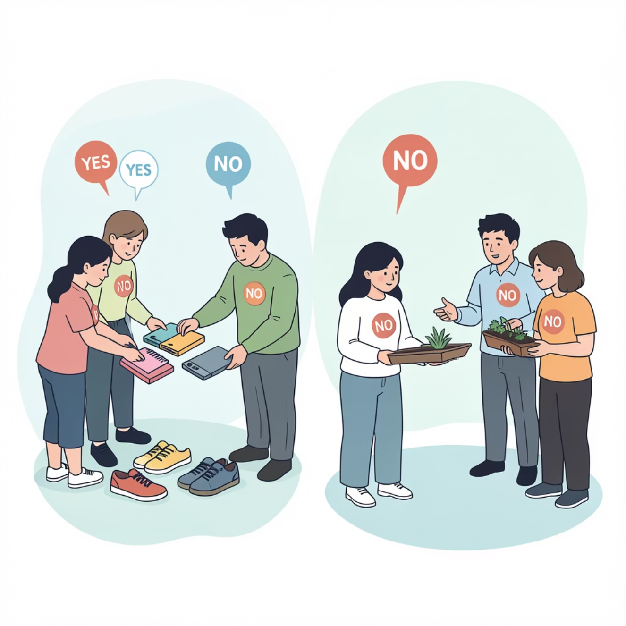
Subscription & Discount Dynamics
Subscribers vs. Non-Subscribers
Discount-Dependent Products
Non-subscribers (2847) generated more revenue ($170,436) than subscribers (1053) ($62,645).
Top 5 products with highest discount usage: Hat (50%), Sneakers (49.66%), Coat (49.07%), Sweater (48.17%), Pants (47.37%).

Slide 6

Customer Segmentation & Product Preferences
1
2
Customer Segmentation
Top 3 Products per Category
Loyal (3116), Returning (701), New (83) customers based on purchase history.
Accessories: Jewelry, Sunglasses, Belt. Clothing: Blouse, Pants, Shirt. Footwear: Sandals, Shoes, Sneakers. Outerwear: Jacket, Coat.
3
Repeat Buyers & Subscriptions
958 repeat buyers (more than 5 purchases) are subscribers, while 2518 are not.

Slide 7
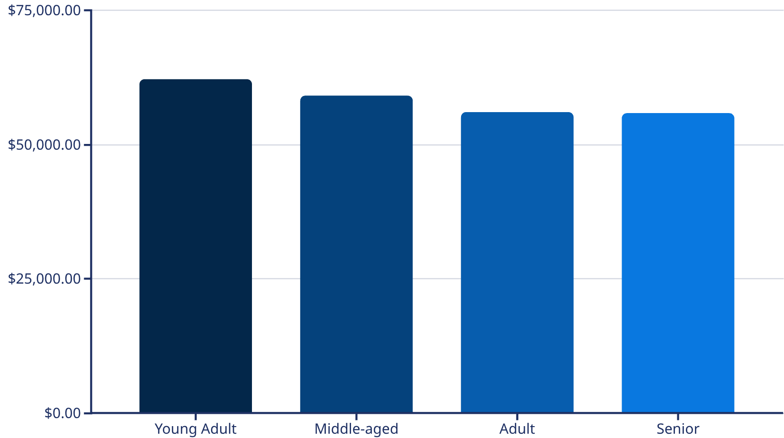
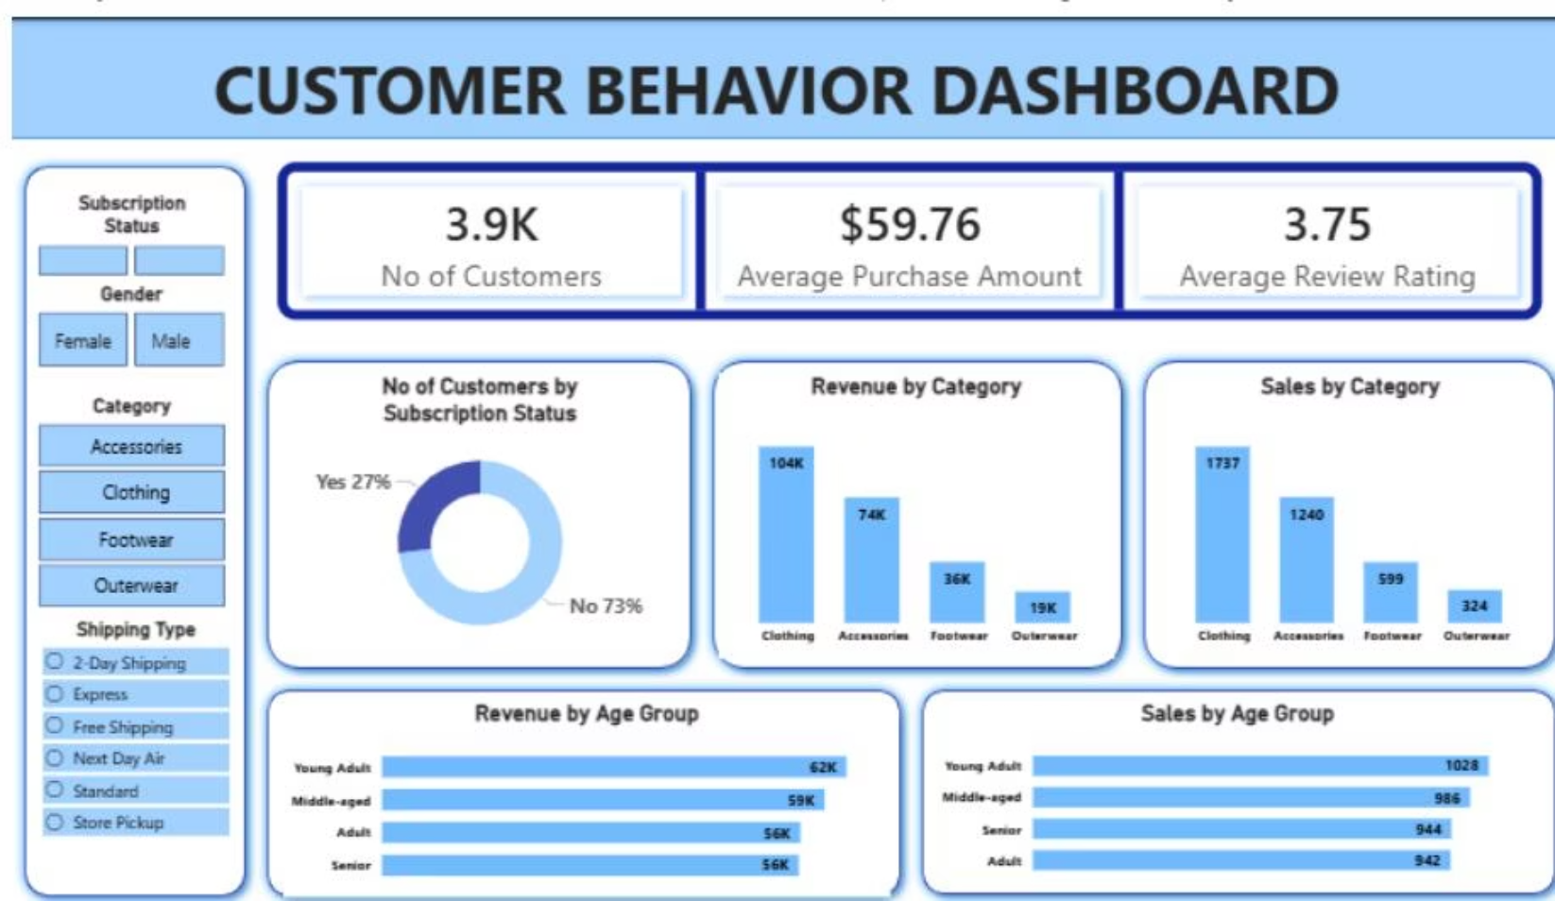
Revenue by Age Group & Power BI Dashboard
Revenue by Age Group
Interactive Dashboard
An interactive Power BI dashboard visualizes these insights, including customer counts, average purchase amounts, and review ratings.
Young Adults contribute the most revenue, followed closely by Middle-aged customers.

Slide 8





Strategic Business Recommendations
Boost Subscriptions
Promote exclusive benefits to increase subscriber base.
Customer Loyalty Programs
Reward repeat buyers to foster loyalty and retention.
Review Discount Policy
Balance sales boosts with margin control for profitability.
Product Positioning
Highlight top-rated and best-selling products in marketing campaigns.
Targeted Marketing
Focus efforts on high-revenue age groups and express-shipping users.

